Slide 1
Announcements
There’ll be a guerrilla section this Sunday, 3-5PM
2nd floor Soda labs
Mid-semester Survey is out
2 points EC for everyone if 90% of students fill it out (currently at 88%)
Project 2 is due Saturday at midnight!
Midterm 2 is next week in lecture!
Room assignments on Piazza
Email staff@cs61bl.org if you have time conflicts
In lecture live Piazza Q&A @625
TAs will answer your questions

Slide 2

CS61BL, Summer 2017
Lecture 4: Balanced Binary Search Trees, Hashing

Slide 3
Balanced Search Trees

Slide 4
The Trouble with Trees
Last time: BSTs have potential performance issue if they get “spindly”
Worst case: Items inserted in order.
Fundamental issue: Too lazy about where to store data.
One solution:
Insert in random order.
Results in Θ(log N) height.
Why don’t we just do this?
7
3
9
1
4
8
10
11
12
13

Slide 5
The Trouble with Trees
Last time: BSTs have potential performance issue if they get “spindly”
Worst case: Items inserted in order
Fundamental issue: Too lazy about where to store data.
One solution:
Insert in random order.
Results in Θ(log N) height.
Why don’t we just do this?
You may not have all your data in advance
7
3
9
1
4
8
10
11
12
13

Slide 6
Solution Attempt #1
The problem is adding new leaves.
Solution: Never add new leaves.
Tree can never get imbalanced.
7
3
10
2
5
8
12
Q: What do we do with incoming keys?
?
?
13
?
15
?
17

Slide 7
Solution Attempt #2
The problem is adding new leaves.
Solution: Overstuff the nodes (to a certain extent).
Tree can never get imbalanced.
7
3
10
2
5
8
12
7
7
3
10
3
10
2
5
8
12 13
2
5
8
12 13 15

Slide 8
2-3-4 Trees

Slide 9
B-Trees
B-Trees are most popular in two specific contexts:
Small order (3 or 4):
Used as a conceptually simple balanced search tree (as today).
Very large order (say thousands)
Used in practice for databases and filesystems (i.e. systems with very large records).
See CS186
Note: Since the small order tree isn’t practically useful (as we’ll see in a few slides, people usually only use the name B-tree to refer to the very large order case.

Slide 10
2-3-4 Trees
Special case of a B-Tree (specifically a B-Tree of order 4)
The name comes from the invariant that a single node can have 2, 3, or 4 children
Every internal node must have one more child than it has entries
The origin of "B-tree" has never been explained by the authors. As we shall see, "balanced," "broad," or "bushy" might apply. Others suggest that the "B" stands for Boeing. Because of his contributions, however, it seems appropriate to think of B-trees as "Bayer"-trees.
- Douglas Corner (The Ubiquitous B-Tree)

Slide 11
2-3-4 Tree Operations: get
V get(K k):
At each node, check for a key matching k.
If not found, move down to the appropriate child by comparing k against the keys in the node.
Continue until k is found, or at a leaf not containing k.
get(3)
20
40
70
10
10
18
26
55
88
90
1
3
4
17
22
39
41
66
77
89
99

Slide 12
2-3-4 Tree Operations: get
V get(K k):
At each node, check for a key matching k.
If not found, move down to the appropriate child by comparing k against the keys in the node.
Continue until k is found, or at a leaf not containing k.
get(3)
20
40
70
10
10
18
26
55
88
90
1
3
4
17
22
39
41
66
77
89
99

Slide 13
2-3-4 Tree Operations: add
add(K k, V v): (inserting key value pair)
Walk down the tree like finding k.
When encountering a 3-key-node, kick the middle value up as shown and split the node
This ensures there’s room when we reach a leaf (and room to kick up)
When reaching a leaf, add the key to its ordered position.
insert(8)
20
20
40
40
70
70
10
10
10
18
26
26
55
55
88
88
90
90
1
1
3
3
4
4
17
17
22
22
39
39
41
41
66
66
77
77
89
89
99
99

Slide 14
2-3-4 Tree Operations: add
insert(8)
Previously a 3-key node. Split the node to make room
40
20
70
10
18
26
55
88
90
1
3
4
17
19
22
39
41
66
77
89
99

Slide 15
2-3-4 Tree Operations: add
insert(8)
insert(8)
40
40
20
20
70
70
10
10
18
18
26
26
55
55
88
88
90
90
1
1
3
3
4
4
17
17
19
19
22
22
39
39
41
41
66
66
77
77
89
89
99
99

Slide 16
2-3-4 Tree Operations: add
insert(8)
It was safe to kick up 3 because we know the parent can’t be full (it would’ve been split)
40
20
70
3
10
18
26
55
88
90
1
4
17
19
22
39
41
66
77
89
99

Slide 17
2-3-4 Tree Operations: add
insert(8)
40
20
70
Reached a leaf, put 8 in
3
10
18
26
55
88
90
1
4
8
17
19
22
39
41
66
77
89
99

Slide 18
2-3-4 Tree Operations: add
insert(8)
Newly created 3-node; will be broken up next time we insert through this path
40
20
70
3
10
18
26
55
88
90
1
4
8
17
19
22
39
41
66
77
89
99

Slide 19
Perfect Balance
Observation: 2-3-4 Trees have perfect balance.
If we split the root, every node gets pushed down by exactly one level.
If we split a leaf node or internal node, the height doesn’t change.
7
2
10 13
1
5
8
12
15 17

Slide 20
2-3-4 Tree Runtimes
The height H of a 2-3-4 Tree is between log₄(N) and log₂(N)
Max number of times we break up 3-Nodes per insert: ~H
Time per insert/contains: Θ(H), or equivalently Θ(log N)
7 13
3
10
16 20 23
2
5
8
11
15
17
21
24 25
Max 3 items per node.
Max 4 non-null children per node.

Slide 21
Red-Black Trees

Slide 22
There’s a Slight Problem...
2-3-4 Trees can be a real pain to implement and suffer from performance problems
The remove() operation (omitted) can be hard to code
If you decide to have different types for each node, maintaining the types can be difficult
Especially converting between types of nodes
“Beautiful algorithms are, unfortunately, not always the most useful” - Knuth

Slide 23
But There’s Hope!
Red-Black trees are binary search trees that maintain the balanced-ness guarantee of 2-3-4 trees.
Maintain certain invariants through rotations:
A node is either red or black.
The root & leaves are black.
If a node is red, both of its children are black.
Every path from a given node to any of its leaf descendants must contain the same number of black nodes.
Convertible to 2-3-4 trees and vice versa
Used in java.util.TreeMap, java.util.TreeSet!

Slide 24
From 2-3-4 Tree to Red-Black Tree
20
40
70
10
18
26
55
88
90
40
20
70
10
26
55
88
nil
18
nil
nil
nil
nil
nil
90
nil
nil
nil
nil

Slide 25
From 2-3-4 Tree to Red-Black Tree
20
40
70
10
18
26
55
88
90
40
1 key nodes correspond to a single black node
20
70
10
26
55
88
nil
18
nil
nil
nil
nil
nil
90
nil
nil
nil
nil

Slide 26
From 2-3-4 Tree to Red-Black Tree
20
40
70
10
18
26
55
88
90
40
20
70
2 key nodes correspond to a black node and a red child
10
26
55
88
nil
18
nil
nil
nil
nil
nil
90
nil
nil
nil
nil

Slide 27
From 2-3-4 Tree to Red-Black Tree
3 key nodes correspond to a black node and two red children
20
40
70
10
18
26
55
88
90
40
20
70
10
26
55
88
nil
18
nil
nil
nil
nil
nil
90
nil
nil
nil
nil

Slide 28
Going the Other Way
20
40
70
10
18
26
55
88
90
40
20
70
Just remember: Black nodes eat the red children to create stuffed nodes
10
26
55
88
nil
18
nil
nil
nil
nil
nil
90
nil
nil
nil
nil

Slide 29
Practice Time!
Draw the Red Black Tree corresponding to the 2-3-4 tree shown below.
10 17
1 5
13
19 21

Slide 30
Solution
Draw the Red Black Tree corresponding to the 2-3-4 tree shown below.
10 17
1 5
13
19 21
Searching an Red-Black tree for a key is easy.
Treat it exactly like any BST.
17
10
21
5
13
19
1

Slide 31
Solution
Draw the Red Black Tree corresponding to the 2-3-4 tree shown below.
10 17
1 5
13
19 21
Adding and removing from a Red-Black tree (by hand)… not so much
Just change it to a 2-3-4 tree, add there, and convert back
17
10
21
5
13
19
1

Slide 32
Splay Trees

Slide 33
Splay Trees
Like a Red-Black Tree, Splay Trees use rotations to maintain its balance
Requires nothing else! No need for colors!
There’s no guarantee of balance, the tree might end up being spindly
BUT the amortized runtime of operations is O(lg N)
We’ll talk about amortization later in the lecture
Optimized for locality of reference
Fast access for items that have been accessed recently
Often the case for real world data sets

Slide 34
Tree Rotation Example
Suppose we have a search tree as shown below:
RotateLeft(11): 11 moves left through its parent promoting itself
Semantics of the tree are completely unchanged! (Still a BST)
6
11
3
11
6
13
1
4
9
13
3
9
12
17
7
10
12
17
1
4
7
10
15
15
Result of RotateLeft(11):
Here, rotation reduced height of tree!
To reverse the operation: RotateRight(6)
Notes:
An alternate way of achieving balance.

Slide 35
Rotation: An Alternate Approach to Balance
Can change the height by 1
Preserves search tree property.
7
11
rotateRight(B)
11
7
>11
>11
rotateLeft(D)
< 7
> 7 and < 11
< 7
> 7 and < 11

Slide 36
Rotation: An Alternate Approach to Balance
Can change the height by 1
Preserves search tree property.
11
rotateRight(7)
7
7
11
>11
rotateLeft(11)
< 7
> 7 and < 11
< 7
> 7 and < 11
>11
Non-obvious fact: Given an arbitrarily unbalanced tree, a sequence of rotations exists that will yield a balanced tree.
We’ll see such a sequence in a bit

Slide 37
Splaying
Splaying a node X means that we make X the root of the tree through a series of rotations
What way we rotate depends on the configuration between X, its parent P, and its grandparent G (if G exists)
6
11
Here we splayed 11
3
11
6
13
1
4
9
13
3
9
12
17
7
10
12
17
1
4
7
10
15
15

Slide 38
How to Splay: Zig-Zag
X is the right child of a left child.
There’s a bend in the path from X to its grandparent
There is a symmetric case for when X is the left child of a right child
G
G
X
rotateRight(X)
P
d
rotateLeft(X)
X
d
P
G
a
X
c
P
a
b
c
d
b
c
a
b

Slide 39
How to Splay: Zig-Zig
X is the left child of a left child.
There’s a straight path from X to its grandparent
There is a symmetric case for when X is the right child of a right child
G
x
rotateRight(P)
P
rotateRight(X)
P
d
a
p
X
G
X
c
b
g
a
b
c
d
a
b
c
d

Slide 40
How to Splay: Zig
X has no grandparent (child of the root)
Make it the root
P
X
rotateRight(X)
X
c
a
P
a
b
b
c

Slide 41
Putting it Together
private void splayNode(TreeNode<K, V> node) {
while (node.parent != null) {
if (node.parent == root) {
zig(node);
} else if ((node.parent == node.parent.parent.left
&& node == node.parent.right)
|| (node.parent == node.parent.parent.right
&& node == node.parent.left)) {
zigZag(node);
} else {
zigZig(node);
}
}
root = node; //Not really necessary but why not
}

Slide 42
Why Splay?
8
7
9
6
5
4
3
2
1

Slide 43
Why Splay?
8
7
9
6
Splay 2
5
4
3
2
1

Slide 44
Why Splay?
8
8
7
9
7
9
6
6
5
ZigZig
5
4
2
3
2
1
3
1
4

Slide 45
Why Splay?
8
8
7
9
7
9
6
2
5
ZigZig again
1
5
4
3
3
6
2
4
1

Slide 46
Why Splay?
One last ZigZig
8
2
7
9
1
7
6
5
8
5
4
3
9
6
3
2
4
1

Slide 47
Why Splay?
8
2
Height = 4
7
9
1
7
Height = 7
6
5
8
5
4
3
9
6
3
2
Splaying 2 greatly improved the balance. Height roughly halved
4
1

Slide 48
When to Splay
put(K key): splay the new node you insert
get(K key): splay the node that contains the key (or the dead end you reached if key was not in the tree)
remove(K key): splay the parent of the node you removed (could be the inorder successor’s parent)

Slide 49
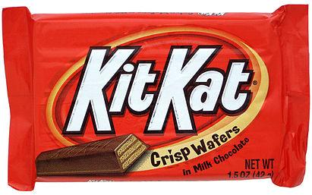
Break (5 minutes)

Slide 50
Hash Sets

Slide 51
Techniques for Implementing Sets: Linked List
B
G
C
F
E
A
D
Worst case runtimes
 | contains(x) | add(x)
Linked List
Θ(N)
Θ(N)
May need to traverse entire list to find an element
To insert, need to check whether new element is already in set first.

Slide 52
Techniques for Implementing Sets: Bushy BST
k
e
v
b
g
p
y
a
d
f
j
m
r
x
z
Limitations:
Items must be comparable
Maintaining bushiness is tricky
Θ(log N) is good*, but can we do better?
Worst case runtimes
 | contains(x) | add(x)
Linked List | Θ(N) | Θ(N)
Bushy BST | Θ(log N) | Θ(log N)
* One billion items yields tree height of only 30.

Slide 53
Techniques for Implementing Sets: Unordered Array
a
z
f
j
r
d
x
m
Worst case runtimes
 | contains(x) | add(x)
Linked List | Θ(N) | Θ(N)
Bushy BST | Θ(log N) | Θ(log N)
Unordered Array | Θ(N) | Θ(N)
May need to resize array upon insertion
Unordered arrays make terrible sets!

Slide 54
Techniques for Implementing Sets: Data as an Index
One extreme approach:
Use data itself as an array index
Store true and false in the array
Downsides of this approach:
Extremely wasteful of memory
Generalization beyond integers not obvious
…but we can fix them!
T
0
1
2
3
4
5
6
7
8
9
10
11
12
13
14
15
F
F
F
F
T
F
F
F
F
T
BooleanSet set = new BooleanSet(16); set.add(0); set.add(5); set.add(10); set.add(11);
T
F
F
F
F
Set containing 0, 5, 10, 11

Slide 55
Rehashing an Old Idea: BooleanSet
public class BooleanSet { boolean[] contains; public BooleanSet(int capacity) { contains = new boolean[capacity]; } public add(int i) { contains[i] = true; } public contains(int i) { return contains[i]; } }
T
0
1
2
3
4
5
6
7
8
9
10
11
12
13
14
15
F
F
F
F
T
F
F
F
F
T
T
F
F
F
F
Set containing 0, 5, 10, 11

Slide 56
Rehashing an Old Idea: BooleanSet
public class BooleanSet { boolean[] contains; public BooleanSet(int capacity) { contains = new boolean[capacity]; } public add(int i) { contains[i] = true; } public contains(int i) { return contains[i]; } }
Worst case runtimes
 | contains(x) | add(x)
Linked List | Θ(N) | Θ(N)
Bushy BST | Θ(log N) | Θ(log N)
Unordered Array | Θ(N) | Θ(N)
BooleanSet | Θ(1) | Θ(1)

Slide 57
Generalized BooleanSet

Slide 58
Generalizing the BooleanSet Idea
0
1
2
3
4
F
a
b
c
d
e
Suppose we want to add(“cat”)
The key question:
What is the cat^{th} element of an array?
Idea: use the first letter of the word as an index
F
T
F
...
F
...

Slide 59
BooleanWordSet Implementation
public void add(String s) { int intRep = convertToInt(s); contains[intRep] = true; } public boolean contains(String s) { int intRep = convertToInt(s); return contains[intRep]; }
0
1
2
3
4
F
a
b
c
d
e
F
T
F
...
F
...

Slide 60
BooleanWordSet Implementation
/** Converts String into an integer by turning
* its first character into a number.
* e.g. 'a' -> 0, 'z' -> 25 */
public static int convertToInt(String s) { int firstChar = s.charAt(0); if ((firstChar < 'a') || (firstChar > 'z')) { throw new IllegalArgumentException(); } return firstChar - 'a'; }
0
1
2
3
4
F
a
b
c
d
e
F
T
F
...
F
...

Slide 61
GeneralizedBooleanSet
Two fundamental challenges:
How do we resolve ambiguity (“cat” vs “chimera”)?
We’ll call this collision handling
How do we convert arbitrary data to an index?
We’ll call this computing a hashCode
For Strings, our approach was straightforward
More on what makes a good hashCode later
0
1
2
3
4
F
a
b
c
d
e
F
T
F
...
F
...

Slide 62
Handling Collisions

Slide 63
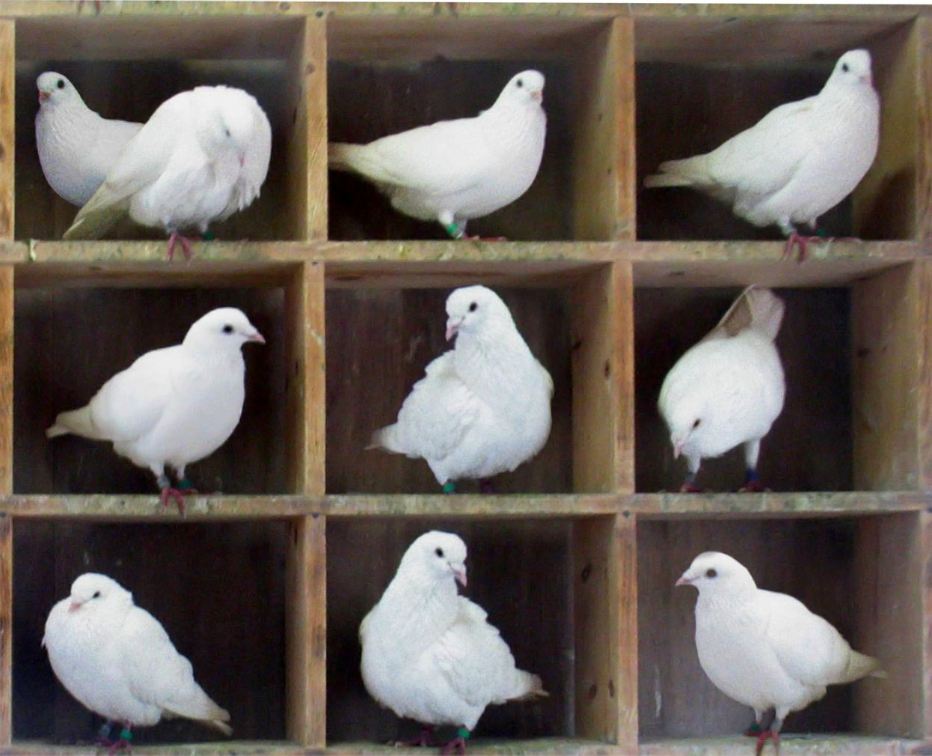
Ambiguity Is Inevitable!
Biggest array in Java is around 2 billion entries
Pigeonhole principle tells us that if there are more than 2 billion possible items, multiple items will share the same box.
Example: there are more than 2 billion possible strings
“one”, “two”, … “two billion and one”, ...

Slide 64
Resolving Ambiguity
Pigeonhole principle tells us that if there are more than 2 billion possible items, multiple items will share the same box.
Suppose N items have the same hashCode h:
Instead of storing true in position h, store a list of these N items at position h
How should this list be implemented?
Easiest way: use a linked list
… but any list would do!

Slide 65
External Chaining
External chaining: storing all items that map to an index h in a linked list
Worst case runtimes
0
1
2
3
15
18
 | contains(x) | add(x)
Linked List | Θ(N) | Θ(N)
Bushy BST | Θ(log N) | Θ(log N)
Unordered Array | Θ(N) | Θ(N)
External Chaining | Θ(Q) | Θ(Q)
cat
dog
...
potato
plato
play-doh
...
snack
...
Why Q and not 1?
Q is the length of the longest chain

Slide 66
External Chaining
Observation: we don’t really need 2 billion (or even 26) buckets
If we only used the 10 buckets on the right, where should our six items go?
0
1
2
3
15
20
0
1
2
3
4
5
6
7
8
9
cat
dog
...
potato
plato
play-doh
...
uranus
...

Slide 67
External Chaining
Idea: can use hashCode % 10 to produce a valid index
Modulus finds the remainder after division of one number by another
0
1
2
3
15
20
uranus
0
1
2
3
4
5
6
7
8
9
cat
cat
dog
dog
...
potato
plato
play-doh
potato
plato
...
uranus
play-doh
...

Slide 68
External Chaining
Idea: can use modulus of hashCode to produce a valid index
Modulus finds the remainder after division of one number by another
In general, compute an object’s index with the following formula:
index = obj.hashCode() modulo bucketCount
Be careful, tricky to implement in Java, as we’ll see.

Slide 69
External Chaining Performance
Depends on the number of items in the `bucket`
If N items are distributed across M buckets, average time grows with N/M = L
L is known as the load factor
Average runtime is Θ(L)
Load factor: 11/6 = 1.83
0
1
2
3
4
5
Observation: if L is small, our data structure will be very fast
Question: as N grows, what can we do to ensure that L stays small?

Slide 70




Array Resizing http://shoutkey.com/ride
Whenever load exceeds some number, increase M by resizing
Question: in which bin will apple appear after resizing?
hashCode() of axe
0
1
2
3
4
5
16
20
0
1
2
3
13
7
Load factor: 4/4 = 1
Load factor: 4/6 = 0.667

Slide 71
Array Resizing
Whenever L = N / M exceeds some number, increase M by resizing
Question: in which bin will apple appear after resizing?
Answer: apple.hashCode() % bucketCount = 7 % 6 = 1
16
20
0
1
2
3
4
5
7
13
0
1
2
3
13
20
7
16
Load factor: 4/4 = 1
Load factor: 4/6 = 0.667

Slide 72

Negative hashCodes http://shoutkey.com/least
Suppose that .hashCode() returns -1.
Question: which bucket is the most natural place for this item?
0
1
2
3

Slide 73
Negative hashCodes
Suppose that .hashCode() returns -1.
Question: which bucket is the most natural place for this item?
Bucket 3, because -1 → 3, 0 → 0, 1 → 1, 2 → 2, 3 → 3, 4 → 0, ...
0
1
2
3
-1

Slide 74
Dealing with Negative hashCodes
Suppose that .hashCode() returns -1.
Unfortunately, -1 % 4 = -1 in Java. Will result in index errors!
Use Math.floorMod instead
public class ModTest { public static void main(String[] args) { System.out.println(-1 % 4); System.out.println(Math.floorMod(-1, 4)); } }
Prints -1. Bad!
Prints 3!

Slide 75
Hash Set Definition and Key Implementation Details
This data structure we’ve designed is called a hash set:
Every item is mapped to a bucket number using a hash function
Typically, computing bucket number consists of two steps:
Computing a hashCode (integer between -2³¹ and 2³¹ - 1)
Compute index with Math.floorMod(hashCode, M)
If L = N/M gets too large, increase M
If multiple items map to the same bucket, we have to resolve ambiguity somehow
External chaining (create a list for each bucket)

Slide 76
External Chaining Performance
0
1
2
3
4
Average case time
 | contains(x) | add(x)
External Chaining, Fixed Size | Θ(L) and Θ(N) | Θ(L) and Θ(N)
External Chaining, w/ Resizing | Θ(L) | Θ(L)
0
1
2
3
4
56
7
8

Slide 77
External Chaining Performance
0
1
2
3
4
Average case time
 | contains(x) | add(x)
External Chaining, Fixed Size | Θ(L) and Θ(N) | Θ(L) and Θ(N)
External Chaining, w/ Resizing | Θ(L) Θ(1) | Θ(L) Θ(1)
0
1
2
3
4
56
7
8
Resizing allows us to control L! Can force L to always be less than some constant.

Slide 78
External Chaining Performance
Average case runtimes
 | contains(x) | add(x)
External Chaining, Fixed Size | Θ(L) and Θ(N) | Θ(L) and Θ(N)
External Chaining, w/ Resizing | Θ(L) Θ(1) | Θ(L) Θ(1)
0
1
2
3
4
0
1
2
3
4
56
7
8
Worst case runtimes
 | add(x)
External Chaining, w/ Resizing | Θ(N)

Slide 79
An Important Detail
Performance depends on the number of items in each `bucket`
Given a load factor of L = N/M:
Average runtime is Θ(L)
Average isn’t the whole story…
Want balanced buckets
Analogous to maintaining bushiness in a BST, but conceptually easier to solve

Slide 80
The hashCode() Method

Slide 81
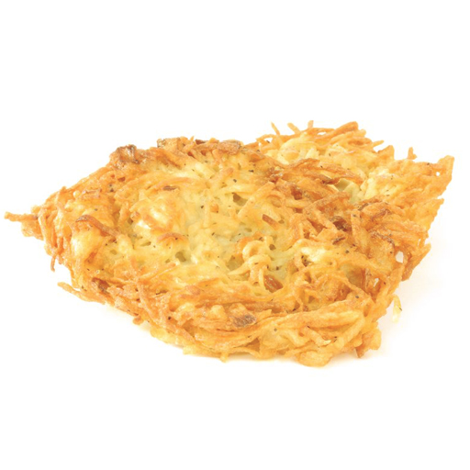
What is hashCode()?
hashCode() is a method defined in the Object class to support hash sets and hash tables
As a result, all Java objects have a hashCode() method
For user-defined objects to interact with hash sets and hash tables correctly, their hashCode methods must obey a contract

Slide 82
The Contract: What Makes a Valid hashCode()?
hashCode() must return the same value consistently when called on the same object
If hashCode() returned a new value every time, it would be impossible to retrieve our objects
Objects that are equal according to the equals(Object) method must have the same hashCode()
Otherwise, two objects that are semantically equal could hash to different buckets

Slide 83
What Makes a Good hashCode()?
Goal: we want hash sets that look like the table on the right
Want a hashCode that spreads things out nicely on real data
Example #1: return 4 is a bad hashCode function
Example #2: our convertToInt function for Strings was bad… only 26 hashCodes possible
Writing a good hashCode() method can be tricky
More on this in lab!

Slide 84
The Object’s hashCode()
The default hashCode() simply returns the object’s address in memory
Can have strange consequences
As a result, you must usually override your type’s hashCode() method if you’ve overriden your type’s equals(Object)
Otherwise, the contract is broken!

Slide 85
A Word of Warning
Warning #1: mutable objects usually shouldn’t be put in a hash set or map
Changes to an object can make it impossible to find again
Warning #2: never override equals(Object) without also overriding hashCode()
Not doing so can cause the hashCode() contract to be broken

Slide 86
Summary
With a good hashCode() and resizing, operations are Θ(1)
No need to maintain bushiness
Though we still need a good hashCode()
Storage and retrieval doesn’t require items to be comparable
Average runtimes
 | contains(x) | add(x)
Linked List | Θ(N) | Θ(N)
Bushy BST | Θ(log N) | Θ(log N)
Unordered Array | Θ(N) | Θ(N)
Hash Set | Θ(1) | Θ(1)

Slide 87
Amortized Analysis

Slide 88
Runtime Analysis http://shoutkey.com/beetle
Assuming you have a good hash function, how long does it take to add N elements to a hash set if the set increases its number of buckets by one every time its load factor exceeds 1.0?
Θ(1)
Θ(log N)
Θ(N)
Θ(N²)
public void add(E elem) { double loadFactor = size / capacity; if (loadFactor > 1.0) { resize(size + 1); } ...
}

Slide 89
Resizing Runtime Analysis
Assuming you have a good hash function, how long does it take to add N elements to a hash set if the set increases its number of buckets by one every time its load factor exceeds 1.0?
Θ(1)
Θ(log N)
Θ(N)
Θ(N²)
Every time we add an element P, we first have to re-hash P - 1 elements
Since sum of 1 + 2 + 3 + … + N = N(N+1)/2, total runtime is quadratic. Awful!

Slide 90
A Solution: Geometric Resizing
Geometric resizing is much faster. But why?
public void add(E elem) { double loadFactor = size / capacity; if (loadFactor > 1.0) { resize(size + 1); } ...
}
Unusably bad
public void add(E elem) { double loadFactor = size / capacity; if (loadFactor > 1.0) { resize(size * 2); } ... }
Great performance

Slide 91
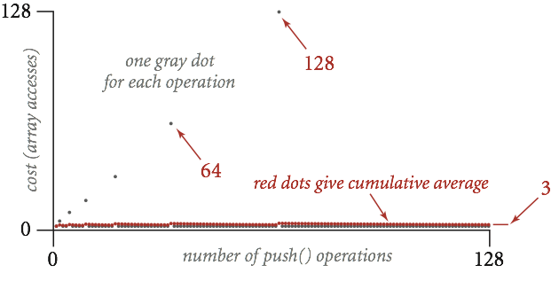
Resizing Runtime Analysis
Hash sets resize to accommodate additional entries
When the hash set exceeds its load factor, double in size
As a result, most add operations are cheap, but some are very expensive
Number of array accesses
Given N items, cost of insert:
Worst case: Θ(N)
Average case: Θ(1) (unproven)
Number of add calls

Slide 92
Amortized Analysis
Looking at worst-case runtime alone gives us a pessimistic impression of the algorithm’s runtime
Amortized analysis allows us to analyze the runtime of operations that are typically fast, but are sometimes more expensive
Want to show that the amortized cost of the hash set’s add operation is bounded by a constant

Slide 93
Amortized Analysis: The Accounting Method
We’ll open a bank account, where we store the time required to execute our operations
All operations have amortized cost c
Each time we execute an operation, we get to deposit c time
Each operation has an actual cost a
Each time we execute an operation, we also withdraw a time
When c > a, we save the extra time in the bank
If our balance goes negative, we lose!

Slide 94
Amortized Analysis: An Analogy
Suppose your parents give you $5 for lunch every day
You’re cheap, so you usually don’t spend the entire $5
The remaining money is saved in your piggy bank
Every now and then, you splurge and go somewhere nice, like JotMahal Palace of Indian Cuisine
In the end, you’ve spent all your money
Even though some lunches were expensive, you still spent $5 dollars per day, on average!

Slide 95
Amortized Analysis: The add Method
Let’s assign add an amortized cost of $3
Insert without resizing costs $1
Suppose we’ve just resized, and we have N/2 elements in our set
This means we are N/2 adds away from the next resizing…
Thus, we will save N/2 * ($3 - $1) = $N before next resize
The next resize requires that we re-hash N elements, which requires $N. Perfect!
So we never go broke, and we have shown that our amortized cost is in Θ(1)

